Slide 1
Numerical Analysis
Week 1
授課老師：羅敏輝
課程助教：
施璟宏 R11229004@ntu.edu.tw
吳宥廷 b07502039@ntu.edu.tw
張筑怡 b09209005@ntu.edu.tw

Slide 2
Numerical Analysis
Class Hours and Location: Mon 13:20-15:10, 大氣系：B105
Instructor: Min-Hui Lo (minhuilo@ntu.edu.tw)
TAs:
施璟宏 R11229004@ntu.edu.tw
吳宥廷 b07502039@ntu.edu.tw
張筑怡 b09209005@ntu.edu.tw

Slide 3
Textbook
Python Programming and Numerical Methods: A Guide for Engineers and Scientists
Class Introduction
介紹在科學與工程上常用的數值方法與其理論基礎，並比較各方法的優缺點。此課程同時借助Python語言軟體進行實習。
課程內容介紹的投影片與影音檔預定會在前一周的星期二23:00上傳至NTUCOOL，並寄信公告，請務必先行預習。
作業將以分組的方式進行，兩個人為一組將作業完成，我們會利用上課時間於 B105完成部分作業，助教和我會從旁協助。每週作業請在星期二22:00之前上傳（one zip file including code and word file），嚴禁抄襲與遲交。
請定期收信件，會利用NTUCOOL寄信跟同學們交代課程相關事情。

Slide 4
Grading: Final grades for the course will be determined using the following weightings:
48% Programming assignments at each class (about 12 times)
20% Midterm
20% Final
12% Final project presentation on 06/12 (6-8 mins video)

Slide 5
WK1(02/20) | Introduction (HW1) Arrange the groups (2 students)
WK2(02/27) | No class
WK3(03/06) | Nonlinear equation I (HW2)
WK4(03/13) | Nonlinear equation II (HW3)
WK5(03/20) | Solving a system of linear equations I (HW4)
WK6(03/27) | Solving a system of linear equations II (HW5)
WK7(04/03) | No class
WK8(04/10) | Curve fitting; Interpolation (HW6)
WK9(04/17) | Midterm
WK10(04/24) | Finite Difference (HW7)
WK11(05/01) | Ordinary differential equation I (HW8)
WK12(05/08) | Ordinary differential equation II (HW9)
WK13(05/15) | Numerical integration (HW10)
WK14(05/22) | Advection and diffusion equations I (HW11)
WK15(05/29) | Advection and diffusion equations II (HW12)
WK16(06/05) | Final exam video record for final project presentation (6-8 mins) + ppt file (with descriptions) 6/12 22:00

Slide 6
2013年諾貝爾化學獎
http://www.ch.ntu.edu.tw/nobel/2013.html
化學反應以閃電的速度進行著，閃避著化學家們虎視眈眈的雙眼。2013年的諾貝爾化學獎得主們利用電腦模擬，讓化學的神祕路徑得以現形。對於化學運作的細部暸解，使得催化劑、藥物以及太陽能電池的最佳化變得更有效率。(by 蔡蘊明老師)

Slide 7
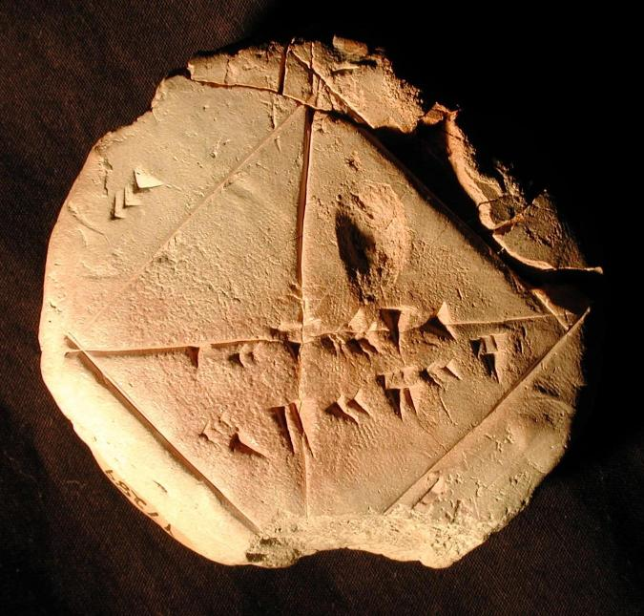
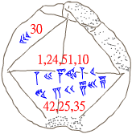
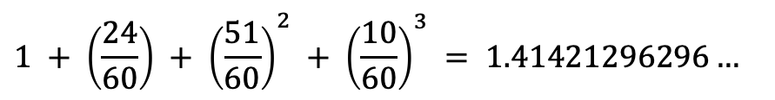
古巴比倫泥板
$$1 + \left(\frac{24}{60}\right) + {\left(\frac{51}{60}\right)}^{2} + {\left(\frac{10}{60}\right)}^{3} = 1.41421296296…$$
10
1
24
51

Slide 8
Numerical analysis (method)
Numerical analysis/method does NOT seek exact answers, because exact answers are often impossible to obtain in practice.
Instead, much of numerical analysis is concerned with obtaining approximate solutions while maintaining reasonable bounds on ERRORS.

Slide 9
Errors
捨入誤差(round-off error)： 浮點運算保留有效位數，除去精度外的數字所造成
For example: MATLAB (or other computer languages) 可以正確計算 1/2 或者 1/5，但是 1 / 3 計算結果是 0.3333；我們知道答案應該是 0.3循環。 這是所有數值計算軟體無法避免的誤差，稱為 (round-off error) 。它是發生在當電腦在利用其有限的位元處理有小數點的數值（如實數，又叫浮點數）會有需要四捨五入的情況。
For example: 若保留小數點後一位，則 1.1 乘以 1.1 的結果就要表示成 1.2 而不是更正確的 1.21。
結尾誤差(truncation error)： 數值方法本身引入之誤差，來自演算法所使用的近似，會有這種名稱是因為演算法常用無窮級數展開的形式，例如
Taylor’s expansion

Slide 10

Errors
$$T_{ε}=T_{estimate}−T_{true}$$
Absolute error: $\left|T_{estimate}−T_{true}\right|$
Relative error: $\frac{{|T_{estimate}−T}_{true}|}{T_{true}}$
How to combine errors?
Please read the article by Robin Hogan, 2006 (Highlight in Yellow)
And summarize it for the HW0.

Slide 11
Purpose of this Class
Learning how to use programming and apply on
Learning several useful numerical schemes
Learning how to solve numerical problems
Learning how to build numerical models (box model)
Let’s practice at every class!

Slide 12
Exercise
Use a “for loop” to write a function to compute the Factorial (!) on a paper

Slide 13
HW1
Read the article by Hogan, 2006 summarize what the error is
Watch two advection animations summarize your thoughts
Finish the Exercise work using python/matlab
upload the above tasks (in one zip file including word files and the code) on NTU COOL (due this Friday, Feb 24 at 22:00)

